Slide 1
DDD and PROJECT
Prezentare Fii Practic

Slide 2
Introduction
Domain Driven Design
Project

Slide 3
Domain DRIVEN DESIGN
Ubiquitous language
Bounded context
Core Domain

Slide 4
Domain DRIVEN DESIGN
Value Based
Entities
Aggregates

Slide 5
PROJECT
We want to develop a cloud base solution for home automation
User will be able to create an account where can manage different sensors.
User will be able to buy some of our products (switches, temperature sensor, humidity sensor, noise sensor, open door / windows sensor)
and register them on their account - each sensor will have a qr code / unique id

Slide 6
PROJECT
Each sensor will be able to send connect to internet and send information to our service
Each 20 seconds our heat / cool switches will read a command service for commands.
Mobile app will send location to our user location service and based on this can decide to start heating / cooling system, a few minute before arriving home

Slide 7
PROJECT
- bonus points: use a weather api to retrieve the outside temperature for the location in a new microservice
- bonus points: create an mvc project that calls the master microservice

Slide 8
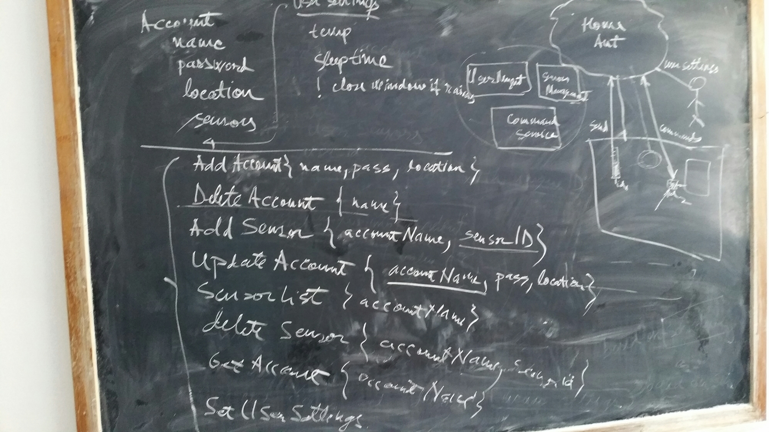

Slide 9
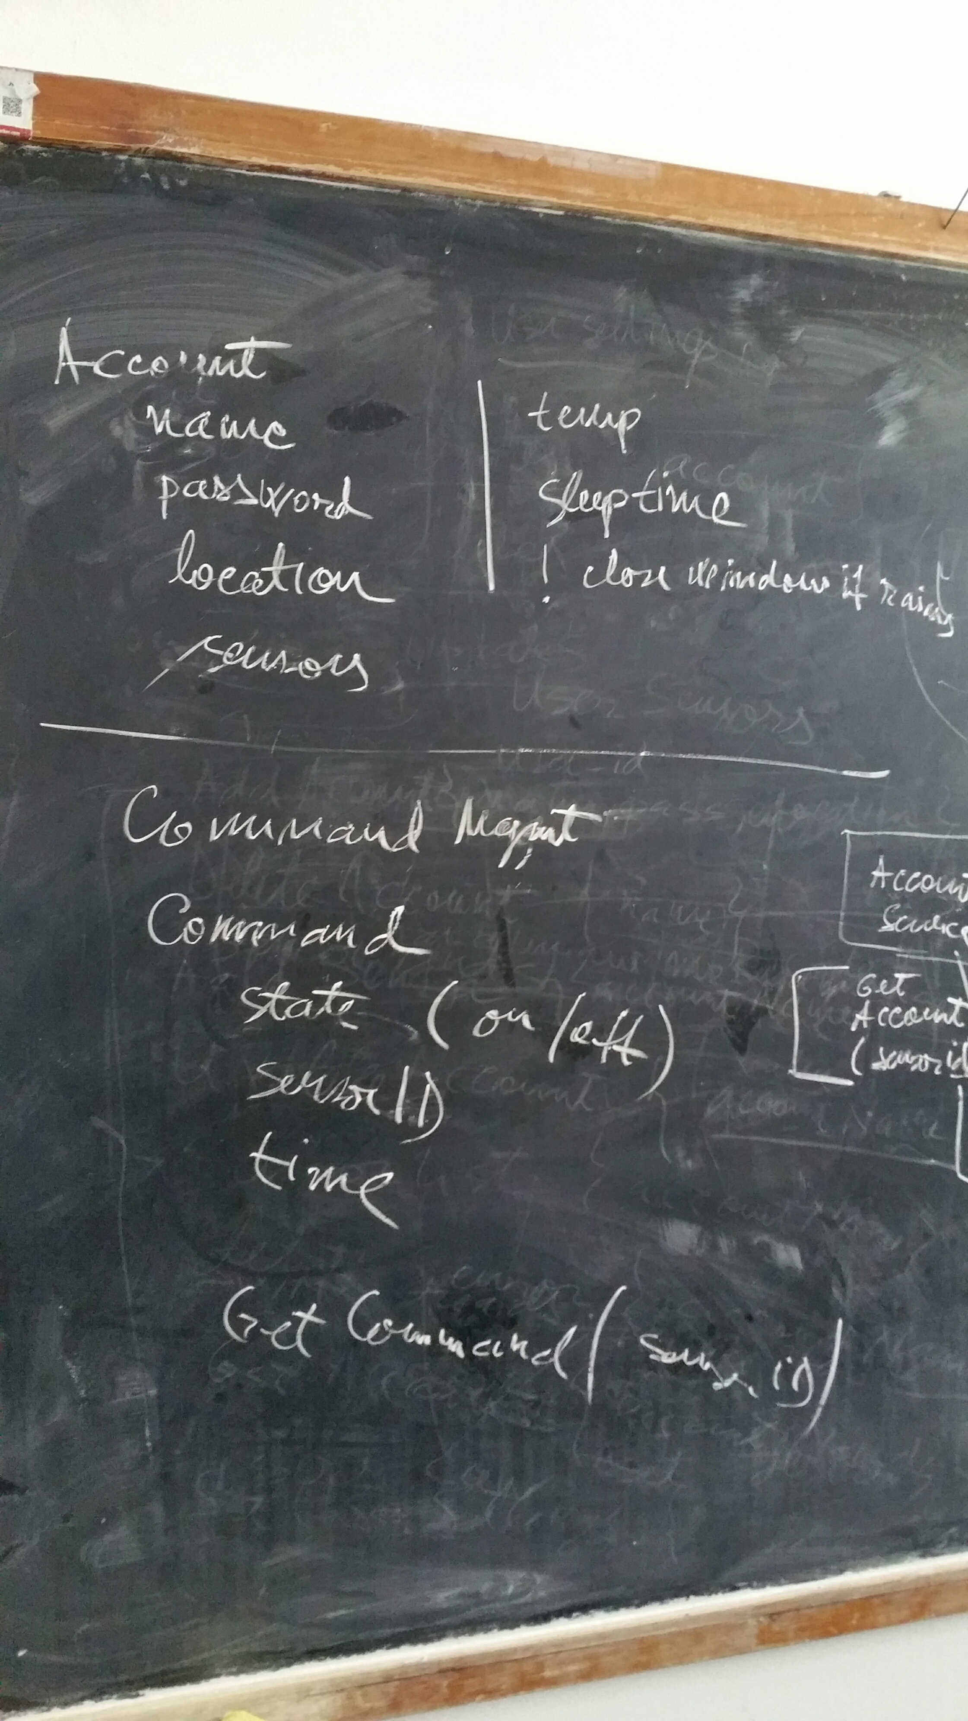

Slide 10
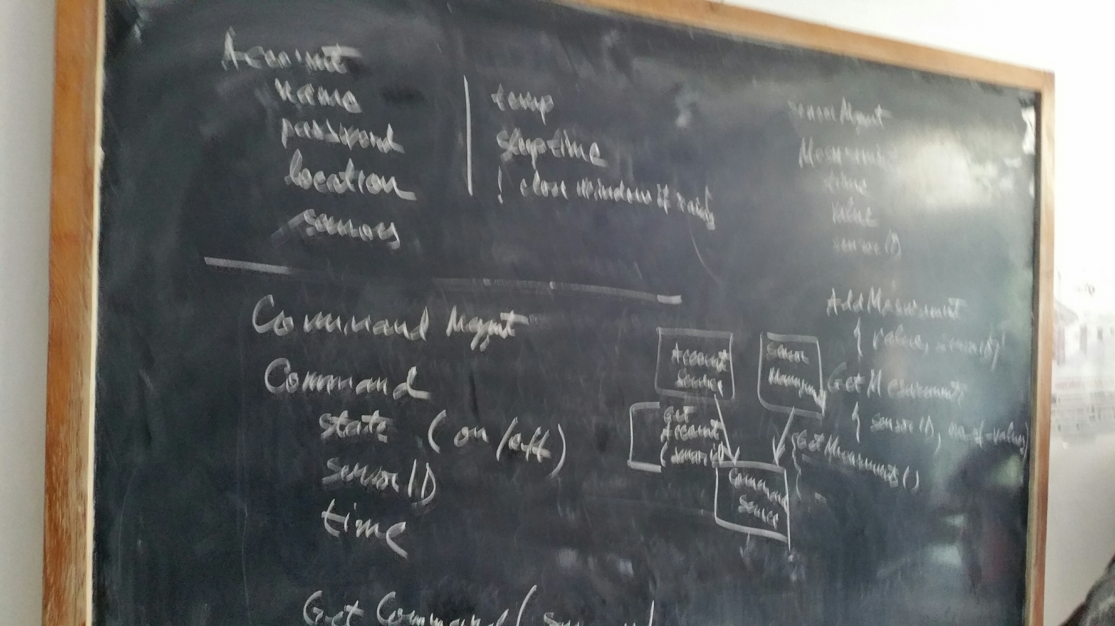

Slide 11
One Common Goal

